Slide 1
Analysis of Cross-border Activities
Intelligence Analyst Assessment
SAFAR KHAN S
2024/08/16

Slide 2
CONTENT
01
Geospatial Analysis
02
Satellite Details Interpretation
03
Correlation with Open-Source Intelligence (OSINT)
04
Threat Assessment and Recommendations

Slide 3
Geospatial Analysis
Task 1

Slide 4


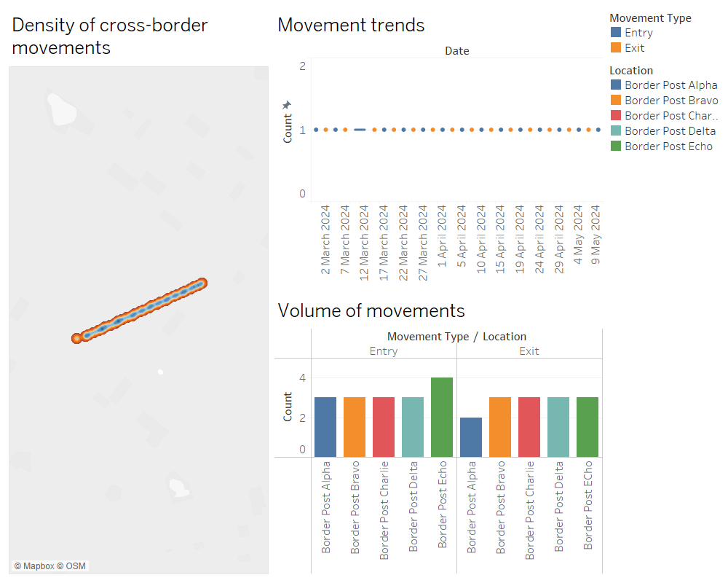
Overview Slide

Slide 5
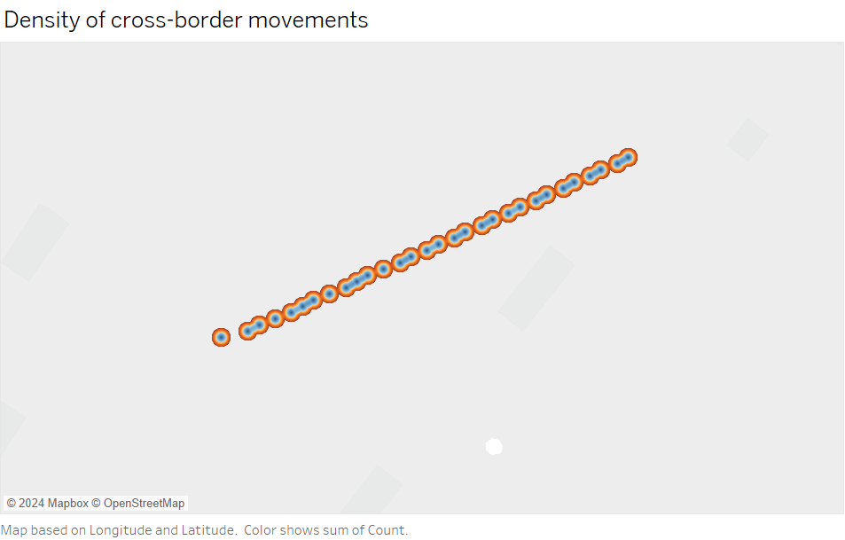
Cross-Border Movement Patterns
*
Heat Map Visualization
The heat map indicates the density of cross-border movements.
Hotspots are areas with a high concentration of movements.

Slide 6
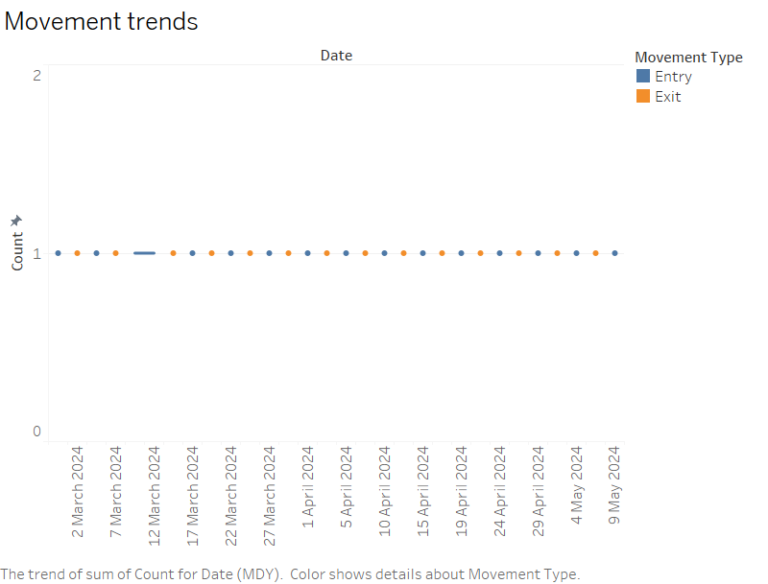
Cross-Border Movement Patterns
*
Identified Hotspots
Border Post Echo: Significant activity observed, indicating a high volume of cross-border movements.
Border Post Charlie, Delta and Bravo: Moderate activity with consistent cross-border movements.
Border Post Alpha: Lower activity compared to other posts but still significant.

Slide 7
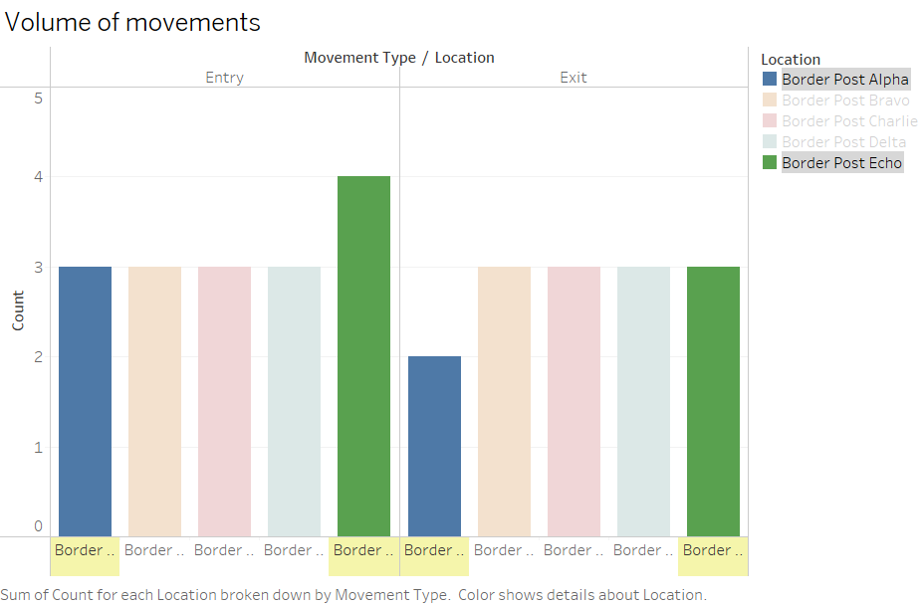
Cross-Border Movement Patterns
*
Anomalies and Unusual Patterns
Border Post Alpha and Echo: Higher frequency of entries compared to exits. Potentially indicating a trend of increased inbound movements.
Border Post Bravo: Balanced movement pattern but with a noticeable peak during certain dates, which could indicate specific events or patterns of movement.
Border Post Echo: Entries show a consistent increase over time, which might be worth monitoring for potential threats or significant changes in cross-border dynamics.

Slide 8
Potential Threats:
Any sudden spikes in movements at specific border posts should be monitored closely.
Unusual patterns, such as an imbalance between entries and exits, could indicate smuggling, illegal crossings, or other security concerns.

Slide 9
Satellite Details Interpretation
Task 2

Slide 10
Analysis of Satellite Images Across Border Posts
Both posts show vehicle movement and infrastructure developments, which could indicate an escalation or preparation for future activities.
Border Post Echo and Foxtrot
Increased military presence and new infrastructure developments were noted, suggesting significant preparations or changes in the area.
Border Post Alpha
Identified Patterns
Border Post Delta
Follows a similar pattern to the other posts, with vehicle movements, increased presence, and new infrastructure indicating possible long-term strategic changes.
Similar patterns as Alpha, with notable troop withdrawal indicating a possible end of activities or redeployment.
Border Post Bravo
Border Post Charlie
Displays a cycle of military buildup and withdrawal, which could indicate temporary operations or exercises.

Slide 11
Conclusion
Potential Cross-Border Movements
Multiple border posts show increased military activities, particularly in Alpha, Bravo, and Delta.
New infrastructure developments suggest preparation for long-term operations.
Troop withdrawal in some areas may indicate redeployment or completion of objectives.

Slide 12
Correlation with Open-Source Intelligence (OSINT)
Task 3

Slide 13
OSINT Correlation Analysis
Analysis Summary
Border Post Alpha
*
Border Post Bravo
*
Geospatial Data: Increased activity in mid-March 2024.
Imagery: Military build-up, infrastructure growth.
OSINT: Accusations of encroachment, firefight with militias.
Correlation: Strong; military presence aligns with reported tensions.
Geospatial Data: Frequent entries/exits in early March 2024.
Imagery: Military presence, vehicle movement, infrastructure developments.
OSINT: Reports of sabotage and clashes.
Correlation: High; imagery supports OSINT reports of tension and border activity.

Slide 14
OSINT Correlation Analysis
Border Post Charlie
*
Border Post Delta
*
Geospatial Data: Frequent movements in early April 2024.
Imagery: Military movements, troop withdrawals.
OSINT: Reported troop movements, clashes with infiltrators.
Correlation: High; imagery indicates reactive measures to reported incidents.
Geospatial Data: Active between late March and early April 2024.
Imagery: Increased presence, infrastructure updates.
OSINT: Reports of military buildup.
Correlation: Consistent; OSINT and imagery show preparation and response activities.

Slide 15
OSINT Correlation Analysis
Border Post Echo
*
Border Post Foxtrot
*
Geospatial Data: Notable movements late April to early May 2024.
Imagery: Military activity, infrastructure growth.
OSINT: No reported incidents.
Correlation: Anomaly; high activity without corresponding reports suggests underreporting or classified operations.
Geospatial Data: Activity peaked between mid-April and early May 2024.
Imagery: Military presence, subsequent infrastructure developments.
OSINT: Border patrol clashes.
Correlation: Strong; matches with reported confrontations.

Slide 16
Impact on Assessment
Geospatial and satellite data align with OSINT reports, indicating that the observed movements and developments are likely responses to reported incidents.
The lack of OSINT for Foxtrot despite significant activity suggests the need for enhanced monitoring and potential intelligence gaps.
The correlation between military movements, infrastructure development, and reported incidents underscores the importance of integrating OSINT with technical data for comprehensive situational awareness.

Slide 17
Threat Assessment and Recommendations
Task 4

Slide 18
Threat Assessment
Border Post Echo:
High Threat Potential: The significant increase in cross-border movements, coupled with new infrastructure developments, indicates potential preparation for large-scale operations or infiltration attempts.
Escalation Risks: The consistent inbound trend suggests a build-up that could precede aggressive actions or heightened conflict in the near future.
Border Post Charlie:
Moderate Threat Level: The cyclical troop deployment and withdrawal pattern indicates ongoing military maneuvers, possibly testing response times or readiness.
Surveillance Necessity: The pattern might be a precursor to more significant actions, warranting close monitoring.

Slide 19
Threat Assessment
Border Post Bravo:
Potential for Sudden Escalation: Balanced movements with noticeable peaks during specific dates suggest events or coordinated operations. The recent troop withdrawal might signal redeployment to another critical area.
Border Post Alpha:
Emerging Concerns: Though lower in activity, the increase in military presence and infrastructure points to potential strategic positioning, making it a location of concern.

Slide 20
Recommendations
Enhanced Surveillance:
Focus on Border Posts Echo and Alpha: Increase the use of UAVs, satellite imagery, and ground reconnaissance to monitor movements and infrastructure developments.
Real-time Monitoring: Deploy real-time surveillance for critical border posts with rapid escalation potential.
Intelligence Gathering:
Cross-Border Activity Analysis: Expand human intelligence (HUMINT) and signal intelligence (SIGINT) efforts to gather information on the intentions behind the movements, especially at Echo and Charlie.
Historical Data Correlation: Cross-reference emerging patterns with past incidents to predict potential hotspots and prepare accordingly.

Slide 21
Recommendations
Diplomatic Engagement:
Preemptive Diplomacy: Engage in diplomatic dialogues with neighboring countries to mitigate rising tensions, particularly in areas showing increased military activity.
International Community Involvement: Alert international bodies to the developments, seeking support for conflict prevention measures.
Preparedness Measures:
Military Readiness: Increase the readiness of border security and military units at critical posts, with contingency plans for potential escalations.
Infrastructure Security: Strengthen and secure vital infrastructure at key border posts, particularly those showing new developments.

Slide 22
THANKS
SAFARKHAN S
2024/08/16

